Slide 1
To Do List
Joe Zipeto

Slide 2
WHY?
Wanted to do a similar project as our Android course
Still was getting familiar with IOS so I didn’t want It to be too complicated
Because I am the only member in the group and I had to do all the work

Slide 3
Features
Uses SQLite instead of coredata
Checks to makes sure users are typing a task in(Cannot add a blank task)
Checks for duplicate tasks
Uses tabbed navigation

Slide 4
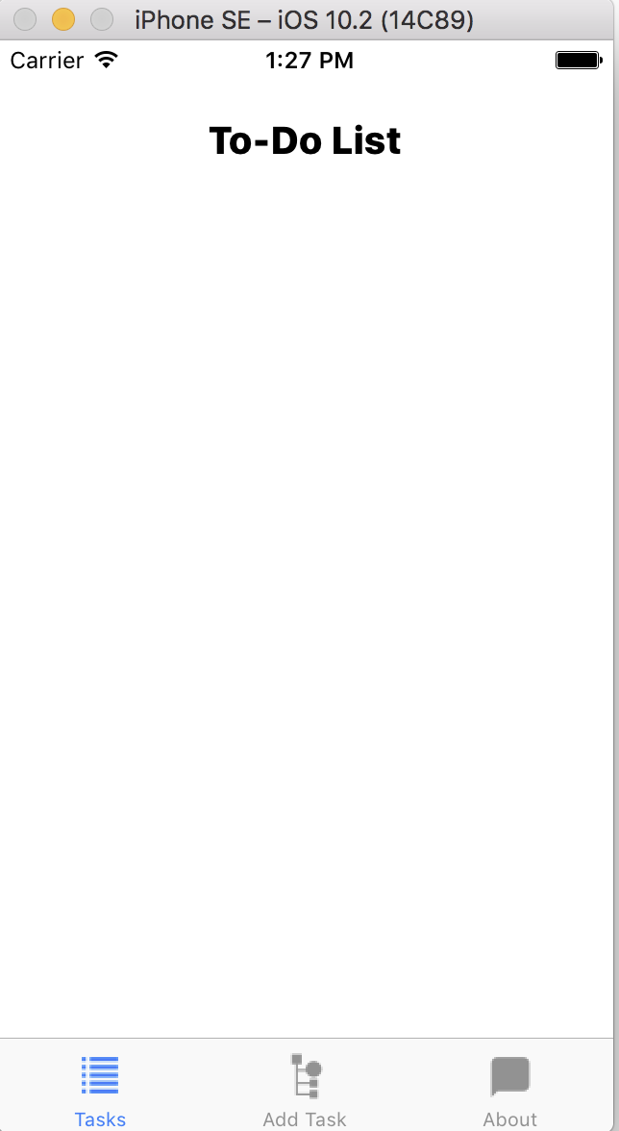
Main Screen

Slide 5
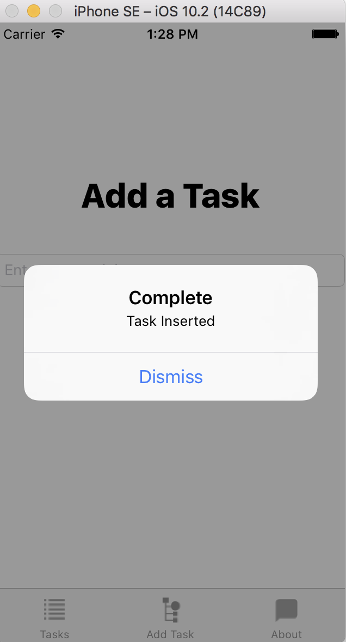
Add task

Slide 6
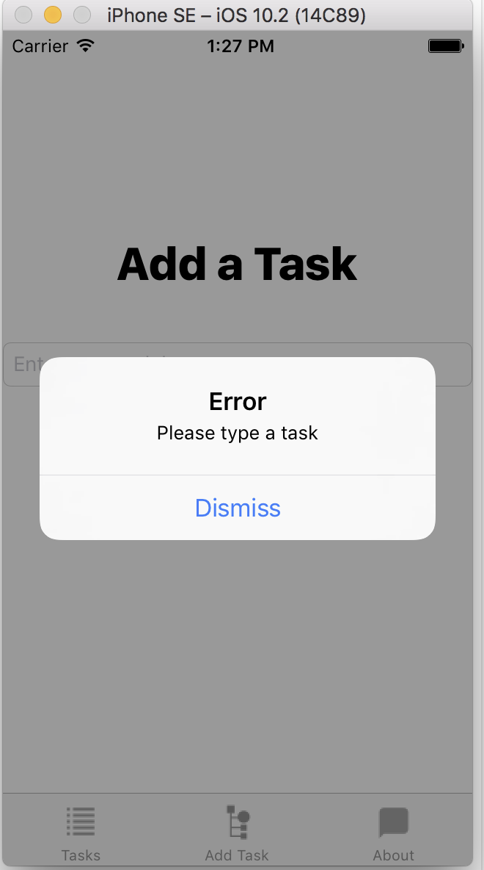
Blank add task

Slide 7
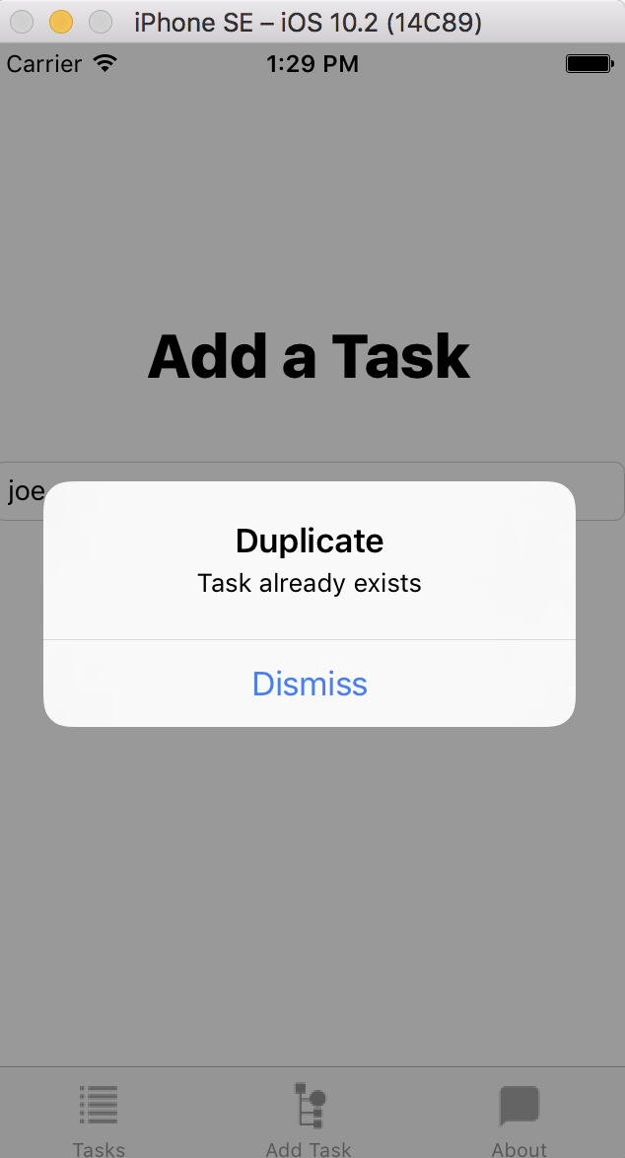
Duplicate task

Slide 8
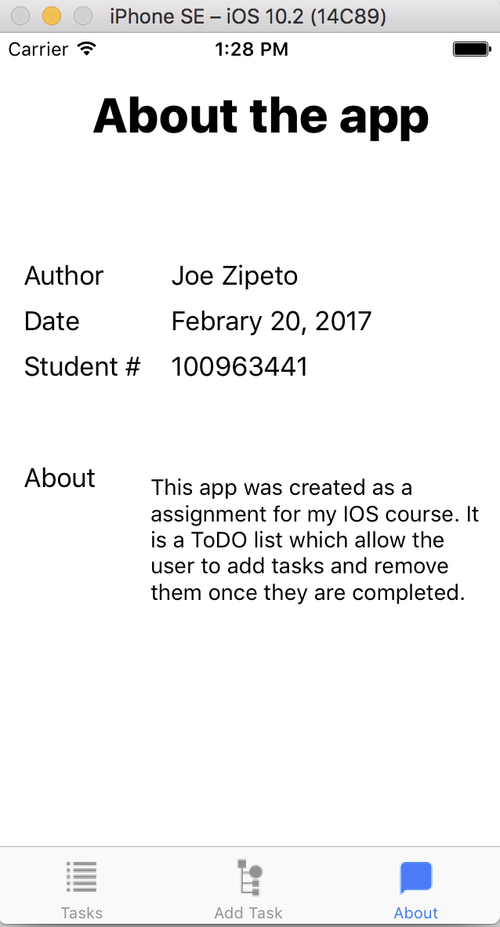
About the app

Slide 9
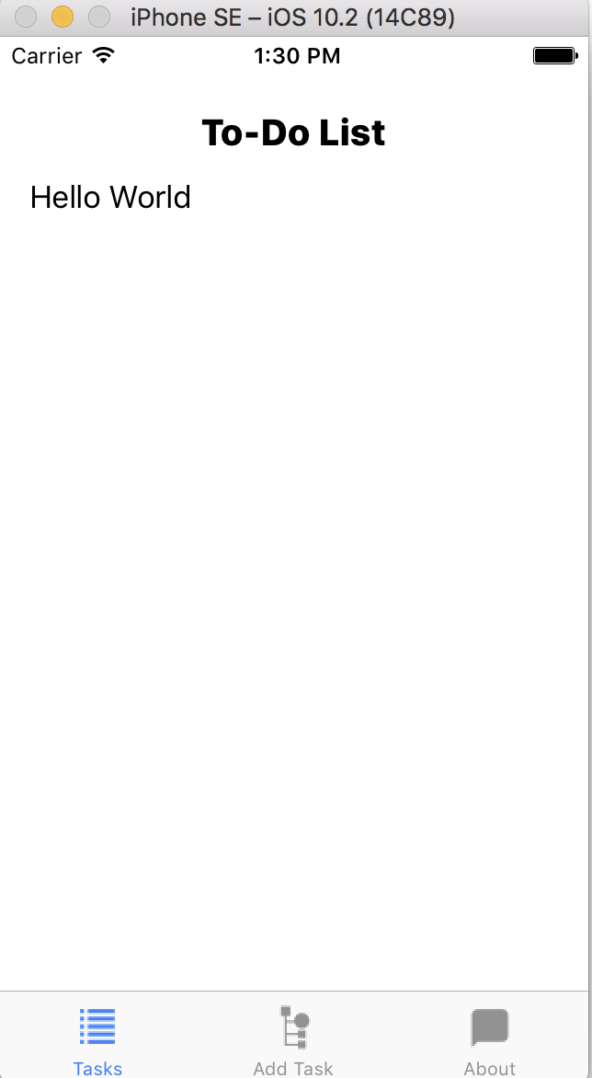
Task added to the list

Slide 10
Problems I had
Getting SQLite to work (https://github.com/stephencelis/SQLite.swift)
Keyboard not going away when you enter a task

Slide 11
QUESTIONS?

